Slide 1

Conditions.

Slide 2
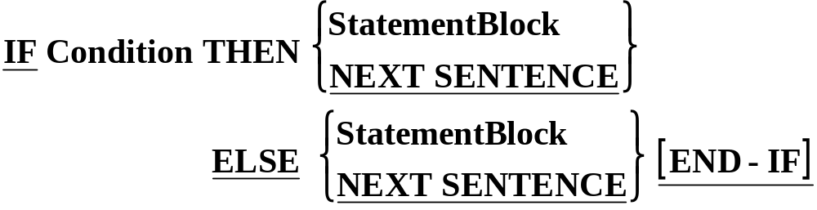
IF Syntax.
CONDITION TYPES
Simple Conditions
  Relation Conditions
  Class Conditions
  Sign Conditions
Complex Conditions
Condition Names

Slide 3
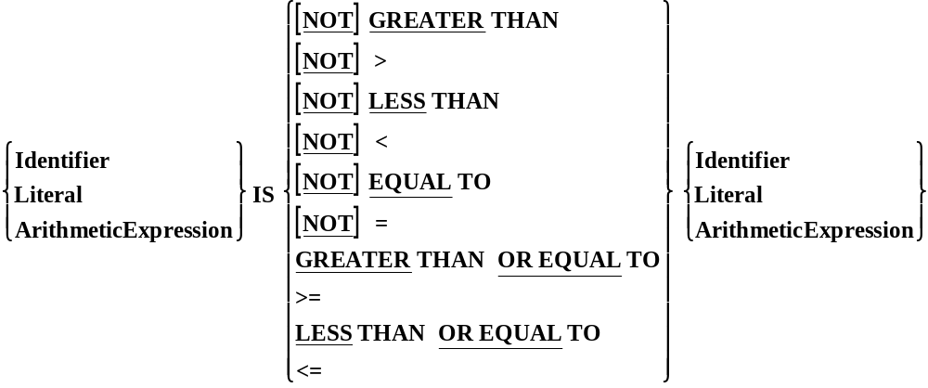
Relation Conditions
Notes:
NOTE :
Notice that the Modula-2 type not equals <> is not permitted.

Slide 4
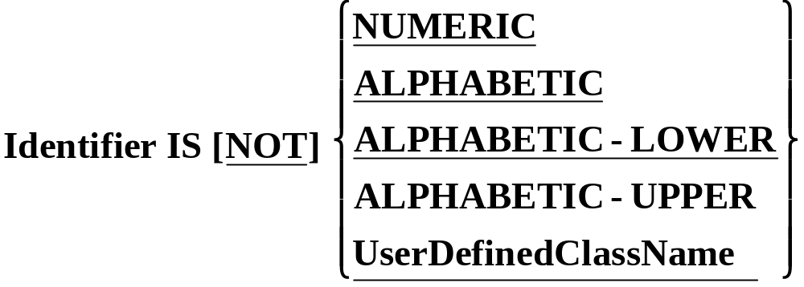
Class Conditions.
Although COBOL data items are not ‘typed’ they do fall into some broad categories, or classes, such a numeric or alphanumeric, etc.
A Class Condition determines whether the value of data item is a member of one these classes.

Slide 5
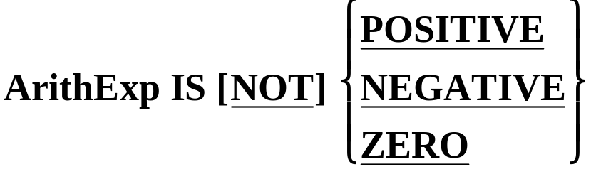
Sign Conditions
The sign condition determines whether or not the value of an arithmetic expression is less than, greater than or equal to zero.
Sign conditions are just another way of writing some of the Relational conditions.

Slide 6
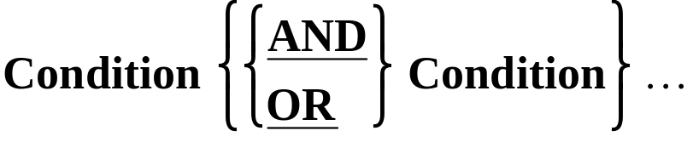
Complex conditions.
Like all other programming languages COBOL allows simple conditions to be combined using OR and AND to form composite conditions.
Like other conditions, a complex condition evaluates to true or false.
A complex condition is an expression which is evaluated from left to right unless the order of evaluation is changed by the precedence rules or bracketing.

Slide 7
Implied Subjects.
IF TotalAmt > 10000 AND TotalAmt < 50000 THEN
  IF Grade = “A” OR Grade = “B+” OR GRADE = “B” THEN
  IF VarA > VarB AND VarA > VarC AND VarA > VarD
  DISPLAY “VarA is the Greatest”
  END-IF
In these situations COBOL provides an abbreviation mechanism called implied subjects.
The statements above may be re-written using implied subjects as;
  IF TotalAmt > 10000 AND < 50000 THEN
  IF Grade=“A” OR “B+” OR “B” THEN
  IF VarA > VarB AND VarC AND VarD
  DISPLAY “VarA is the Greatest”
  END-IF

Slide 8
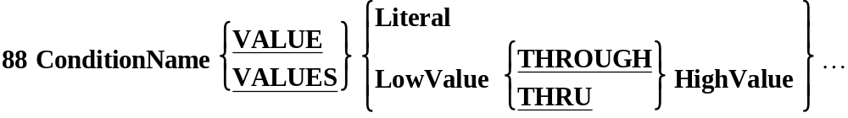
Condition Names.
Wherever a condition can occur, such as in an IF statement or an EVALUATE or a PERFORM..UNTIL, a CONDITION NAME (Level 88) may be used.
A Condition Name is essentially a BOOLEAN variable which is either TRUE or FALSE.

Slide 9
Defining Condition Names.
Condition Names are defined in the DATA DIVISION using the special level number 88.
They are always associated with a data item and are defined immediately after the definition of the data item.
A condition name takes the value TRUE or FALSE depending on the value in its associated data item.
A Condition Name may be associated with ANY data item whether it is a group or an elementary item.
The VALUE clause is used to identify the values which make the Condition Name TRUE.

Slide 10
01 CityCode PIC 9 VALUE 5.
88 Dublin VALUE 1.
88 Limerick VALUE 2.
88 Cork VALUE 3.
88 Galway VALUE 4.
88 Sligo VALUE 5.
88 Waterford VALUE 6.
88 UniversityCity VALUE 1 THRU 4.
IF Limerick
DISPLAY "Hey, we're home."
END-IF
IF UniversityCity
PERFORM CalcRentSurcharge
END-IF
City Code
2
Dublin FALSE
Limerick TRUE
Cork FALSE
Galway FALSE
Sligo FALSE
Waterford FALSE
UniversityCity TRUE

Slide 11
01 CityCode PIC 9 VALUE 5.
88 Dublin VALUE 1.
88 Limerick VALUE 2.
88 Cork VALUE 3.
88 Galway VALUE 4.
88 Sligo VALUE 5.
88 Waterford VALUE 6.
88 UniversityCity VALUE 1 THRU 4.
IF Limerick
DISPLAY "Hey, we're home."
END-IF
IF UniversityCity
PERFORM CalcRentSurcharge
END-IF
City Code
6
Dublin FALSE
Limerick FALSE
Cork FALSE
Galway FALSE
Sligo FALSE
Waterford TRUE
UniversityCity FALSE

Slide 12
01 InputChar PIC X.
88 Vowel VALUE "A","E","I","O","U".
88 Consonant VALUE "B" THRU "D", "F","G","H"
"J" THRU "N", "P" THRU "T"
"V" THRU "Z".
88 Digit VALUE "0" THRU "9".
88 LowerCase VALUE "a" THRU "z".
88 ValidChar VALUE "A" THRU "Z","0" THRU "9".
IF ValidChar
DISPLAY "Input OK."
END-IF
IF LowerCase
DISPLAY "Not Upper Case"
END-IF
IF Vowel
Display "Vowel entered."
END-IF
Input Char
E
Vowel TRUE
Consonant FALSE
Digit FALSE
LowerCase FALSE
ValidChar TRUE

Slide 13
01 InputChar PIC X.
88 Vowel VALUE "A","E","I","O","U".
88 Consonant VALUE "B" THRU "D", "F","G","H"
"J" THRU "N", "P" THRU "T"
"V" THRU "Z".
88 Digit VALUE "0" THRU "9".
88 LowerCase VALUE "a" THRU "z".
88 ValidChar VALUE "A" THRU "Z","0" THRU "9".
IF ValidChar
DISPLAY "Input OK."
END-IF
IF LowerCase
DISPLAY "Not Upper Case"
END-IF
IF Vowel
Display "Vowel entered."
END-IF
Input Char
4
Vowel FALSE
Consonant FALSE
Digit TRUE
LowerCase FALSE
ValidChar TRUE

Slide 14
01 InputChar PIC X.
88 Vowel VALUE "A","E","I","O","U".
88 Consonant VALUE "B" THRU "D", "F","G","H"
"J" THRU "N", "P" THRU "T"
"V" THRU "Z".
88 Digit VALUE "0" THRU "9".
88 LowerCase VALUE "a" THRU "z".
88 ValidChar VALUE "A" THRU "Z","0" THRU "9".
IF ValidChar
DISPLAY "Input OK."
END-IF
IF LowerCase
DISPLAY "Not Upper Case"
END-IF
IF Vowel
Display "Vowel entered."
END-IF
Input Char
g
Vowel FALSE
Consonant FALSE
Digit FALSE
LowerCase TRUE
ValidChar FALSE

Slide 15
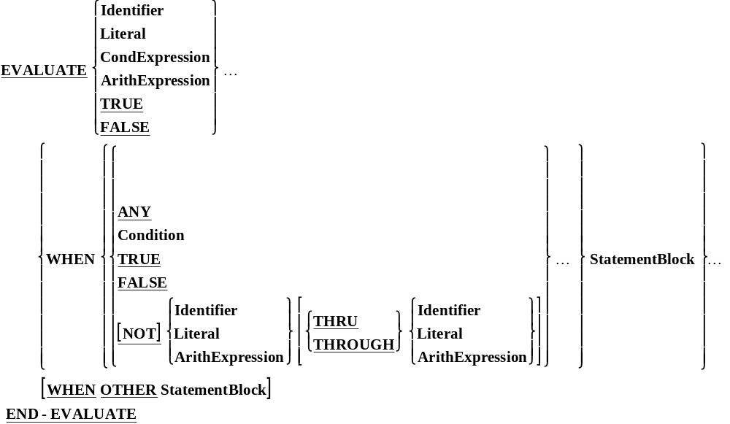
The Evaluate

Slide 16
Example - 1
EVALUATE TRUE
WHEN MONTH = 4 OR 6 OR 9 OR 11
MOVE 30 TO NO-OF-DAYS
WHEN MONTH = 2
MOVE 28 TO NO-OF-DAYS
WHEN OTHERS
MOVE 31 TO NO-OF-DAYS
END-EVALUATE.

Slide 17
Example - 2
EVALUATE MARKS
WHEN 80 THRU 100
MOVE “A” TO GRADE
WHEN 60 THRU 79
MOVE “B” TO GRADE
WHEN 45 THRU 59
MOVE “C” TO GRADE
WHEN 30 THRU 44
MOVE “D” TO GRADE
WHEN ZERO THRU 29
MOVE “E” TO GRADE
WHEN OTHERS
MOVE “W” TO GRADE
END-EVALUATE.
NOTE: “W” is moved in the case of wrong MARKS.

Slide 18
Redefines And Rename Clause

Slide 19
Redefines Clause
Sometimes it may be found that two or more storage areas defined in the data division are not in use simultaneously.In such cases only one storage area can serve the purpose of two or more areas if the area is redefined.
01 SALES-RECORD.
02 SALES-TYPE PIC X
02 SALES-BY-UNIT.
03 QTY PIC 9(4).
03 UNIT-PRICE PIC 9(8)V99.
02 TOTAL-SALES REDEFINES SALES-BY-UNIT.
03 AMOUNT PIC 9(10)V99.
03 FILLER PIC X(2).

Slide 20
LEVEL-NUMBER Data-Name-1 REDEFINES Data-Name-2
The level-number of Data-Name-1 And Data-Name-2 must be identical.
Except when the REDEFINES clause is used to 01 level, Data-Name-1 and Data-Name-2 must be of the same size.
The REDEFINES clause must immediately follow Data-Name-1.
The REDEFINES clause must not be used for Level-number 66 or 88 items.
The REDEFINES clause must not be used for records (01 level) describes in the FILE SECTION. The appearance of multiple 01 entries in the record description is implicitly assumed to be the redefinition of the first 01-level record.

Slide 21
Renames Clause
Sometimes a re-grouping of elementary data items in a record may be necessary so that they can belong to the original as well as to the new group. This is possible in COBOL by the use of the RENAMES clause.
01 PAY-REC..
03 FIXED-PAY.
05 BASIX PAY PIC 9(3)
05 DEARNESS-ALLOWANCE PIC 9(4)
03 ADDITIONAL-PAY.
05 HOUSE-RENT PIC 9(2)
05 MTHLY-INCENTIVE PIC 9(3)
03 DEDUCTIONS.
05 PF-DEDUCT PIC 9(3).
05 IT-DEDUCT PIC 9(3)
05 OTHER-DEDUCT PIC 9(3)
66 PAY-OTHER-THAN-BASIC RENAMES DEARNESS-ALLOWANCE THRU
MTHLY-INCENTIVE.
66 IT-AND-PF-DEDUCTIONS RENAMES PF-DEDUCT THRU IT-DEDUCT.

Slide 22
66 Data-Name-1 RENAMES Data-Name-2 THRU Data-Name-3
All RENAMES entries must be written only after the last record description entry.
Data-Name-2 and Data-Name-3 can be the names of elementary items or group items. They, however. Cannot be items of Level 01,66,77 or 88.
Neither Data-Name-2 nor Data-Name-3 can have an OCCURS clause in its description entry .
Data-Name-3, if mentioned must fallow Data-Name-2 in the record and must not be one of its sub fields.

